Slide 1
Programming Logic and Design
Week 4 - Flow Control, second part
for loops and while loops

Slide 2


Loops - repeating things
Computers were designed to help automate boring, repetitive tasks
Loops are used for repeating tasks, for example
Creating an official transcript for every graduating student
Image filtering - converting every pixel in an image
Keep asking for input until the user enters valid data
Add up every temperature over the winter to compute the average
@jorengoessens via Unsplash

Slide 3
Two types of loops
for loops – if you know how many times you need to repeat a task
Mail a bank statement to every customer
Get expenses data for every month of the year – ask 12 times
while loops – if are not sure how many times you need to repeat a task (or even if you need to repeat it at all) but you'll be able to figure out when to stop as your program is working on the repeating task
Example: checking user input and asking them to try again if input is invalid – for example, stop asking them to entering credit card number when the credit card number is valid

Slide 4
for loops
Sometimes you know how many times you want to do something
for loops are useful for this

Slide 5
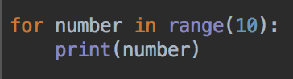
for loops
Start a new Python program
Enter this code
Run and look at the output

Slide 6
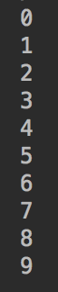
for loops
Run and look at the output
Should be the numbers 0 to 9
Computers start counting from 0
So, if you ask a computer to count ten numbers, it will count
0, 1, 2, 3, 4, 5, 6, 7, 8, 9
The loop repeats 10 times
Can you modify this program to print the numbers 0 to 4?
Can you modify this program to print the numbers 0 to 99?

Slide 7
range()
range() is a function
The range function is useful if you need to do something a particular number of times
It's also useful if you need to count, but don't forget that it will count from 0 to (argument - 1)
10 is the argument to the range function

Slide 8
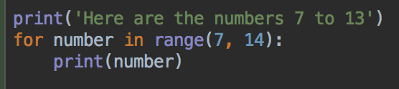
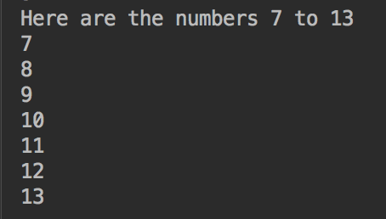
range()
Can customize where to start counting from by modifying the arguments
Can you write a loop that prints the numbers 4, 5, 6, 7, 8?
Can you write a loop that prints the numbers 100 to 200?

Slide 9
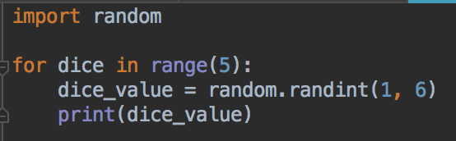
Rolling 5 dice
Write this program, run and test
Let's think about some improvements
It's not very flexible - what if we want to roll 3 dice?
How does the user know what the program does?

Slide 10
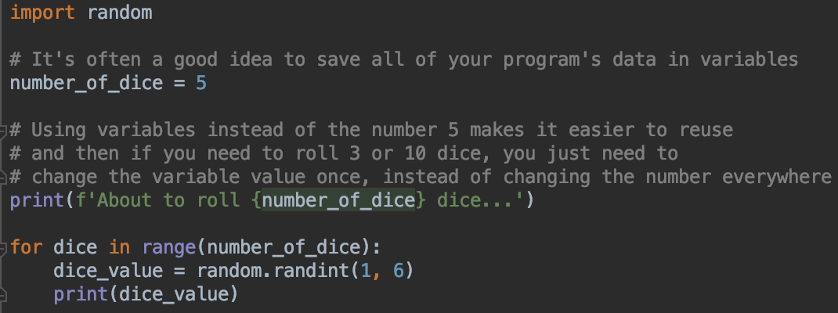
Rolling dice v2
And, move the number of dice to a variable
A message for the user

Slide 11
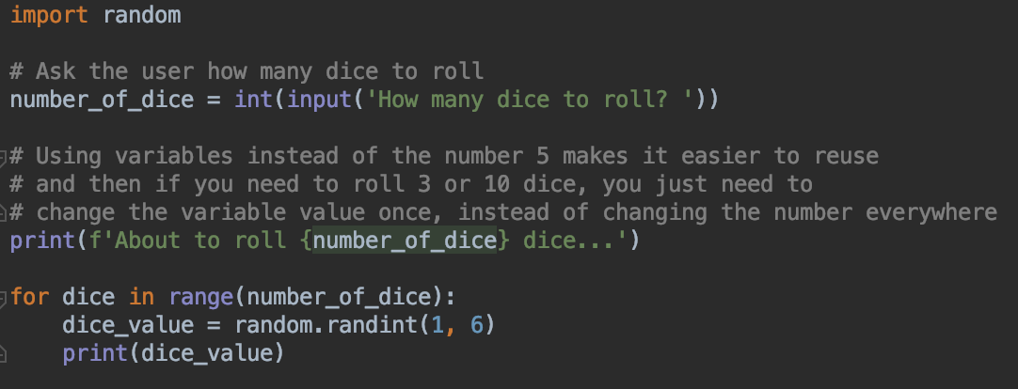
Rolling dice v3
input statement – user can customize program

Slide 12
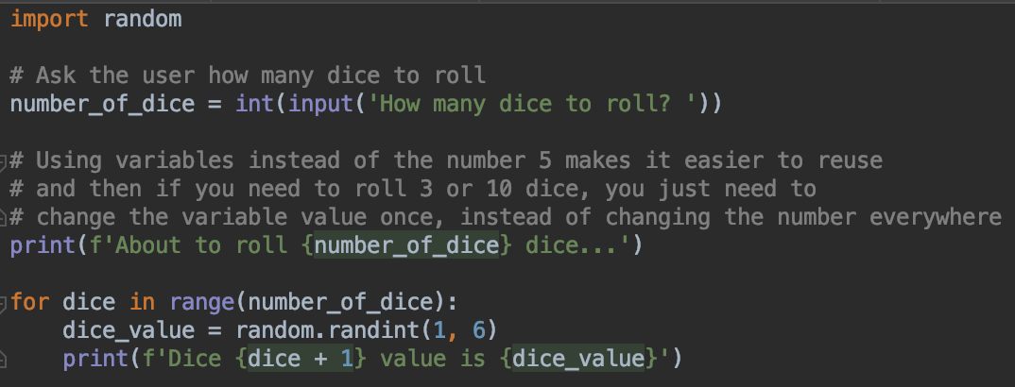
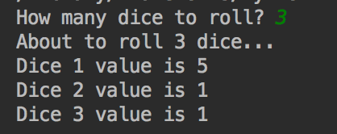
Rolling dice v4
Make output more informative using format string
Notice you can do math and other operations within a format { }
What would the output look like without the +1 ?

Slide 13
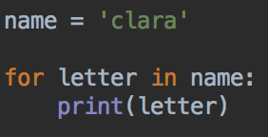
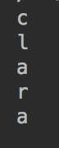
Looping over strings
You can loop over all the letters in a string
Type in this program, but use your name

Slide 14
for loops
You put any logic you like inside the for loop
So you can write if statements inside for loops
Or more for loops inside for loops
Or a while loop inside a for loop
Or whatever you need to solve the programming problem

Slide 15
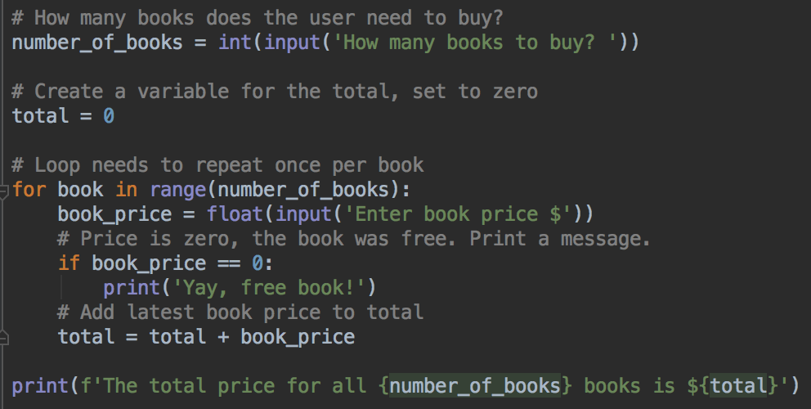
for loops and if statements

Slide 16
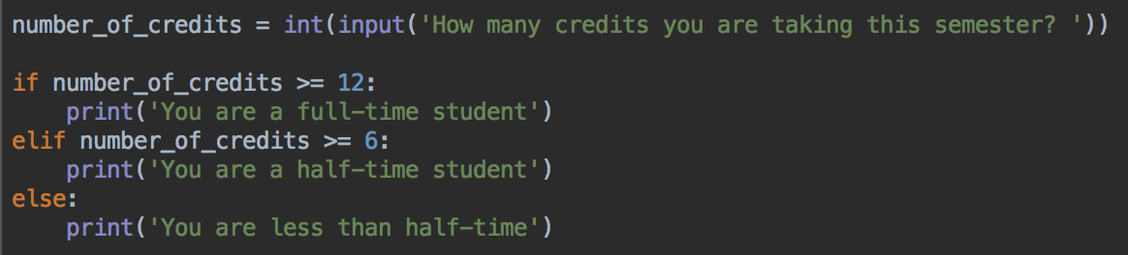
while loops
Remember the full-time, part time program?
What happens if you enter -10 for the number of credits?

Slide 17
while loops
Remember the full-time, part time program?
What happens if you enter -10 for the number of credits?
I guess that's correct..
But it's not possible to take a negative number of credits
So, it would be better to ask the user to try again if they enter an invalid number – repeat while the input is invalid

Slide 18
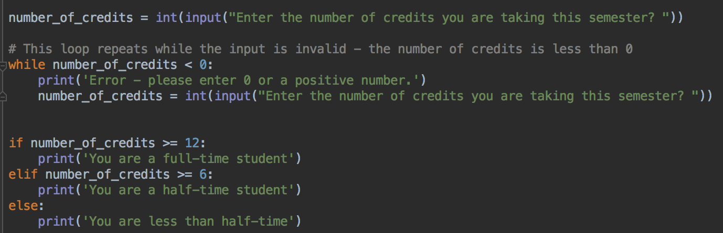
Modify the full-time program like this

Slide 19
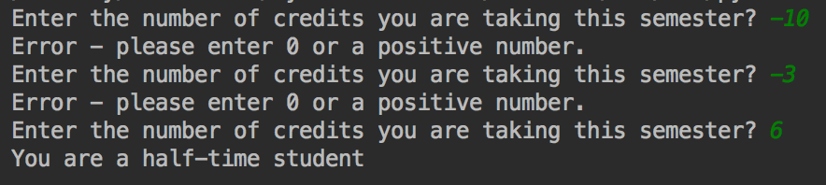
Run and test
Try with example negative and positive numbers
As soon as you enter a positive number, the program will continue to the if-statements to check full time, half time
If the first number entered is positive, there's no error message

Slide 20
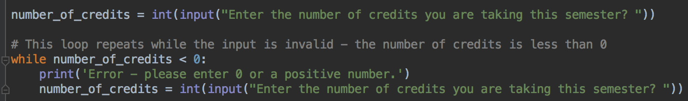
while loops
Structure is like an if statement
But, if the condition is true, the code inside the while block repeats
And repeats
And repeats
....
Until the condition is true
A condition, something that's True or False

Slide 21
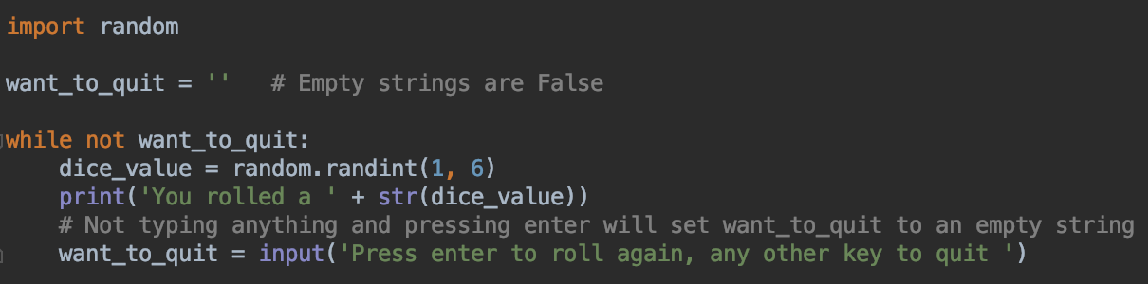
while loop - repeat as many times as the user wants
Remember that empty strings are falsy

Slide 22
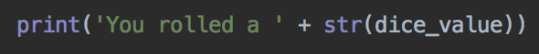
Some more examples of string formatting (f-strings)
Replace this line
With this version - notice the f at the start of the string
The variable dice_value is inside { } and is part of the string
Run the program again. What does the output look like?

Slide 23
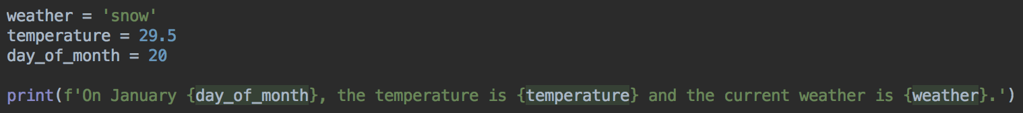
Formatting Strings
Put f before the string
Put your variables - of any type - inside { }
The string will contain the value of the variables
No need to convert to str()

Slide 24
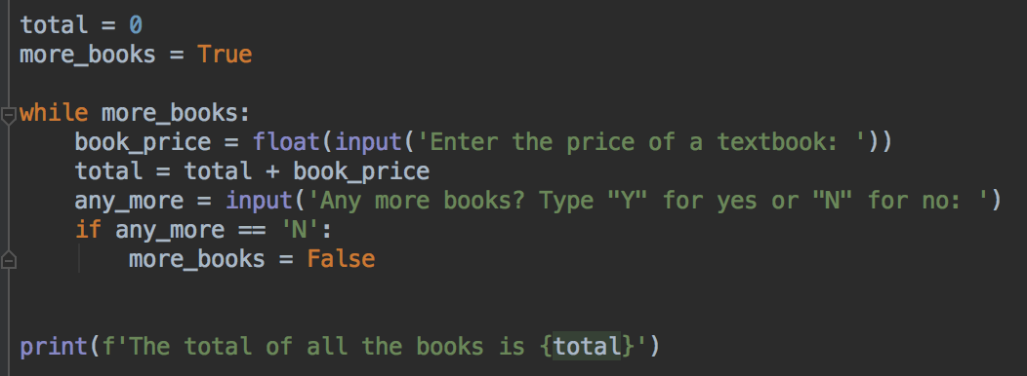
Format strings
More concise
Which version do you think is easier to type? Which is more readable?
Format string

Slide 25
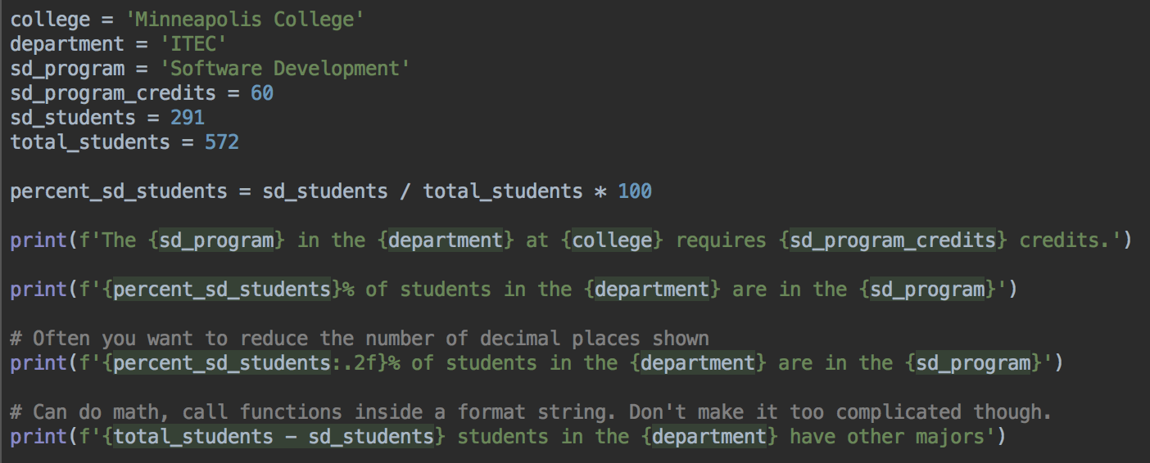
Format strings

Slide 26
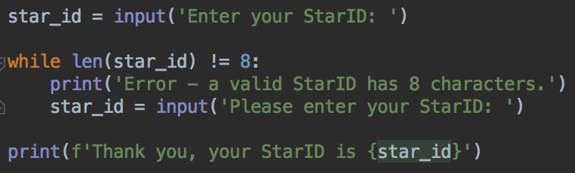
While loops
Validating a string - does a StarID have 8 characters?
An improvement would be to check if the StarID is in the correct pattern ab1234dc. See extra credit question in lab.

Slide 27
If statements and while loops
You can put if statements inside while loops
You can put a while loop inside an if statement
Combining loops, if-statements, and functions (next week) is how we can build more complex, useful, and interesting programs

Slide 28
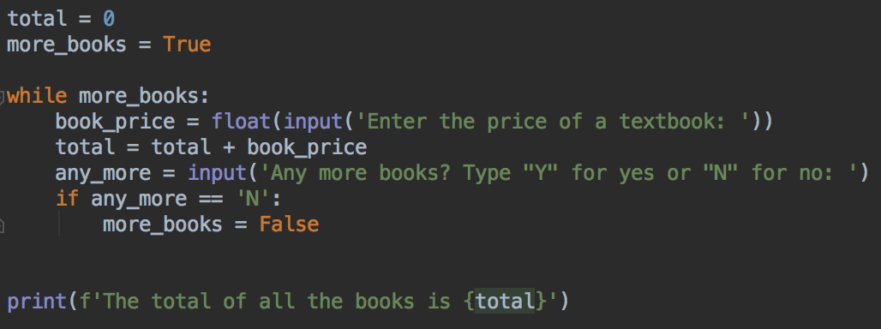
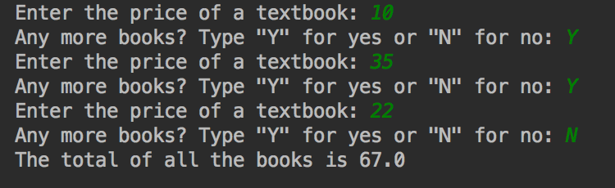
While loop - repeat until user is done

Slide 29
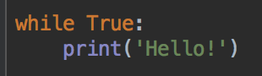
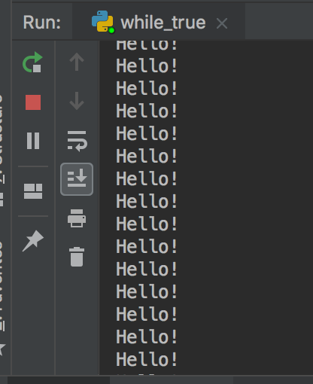
while True
Start a new program and write this code. What does it do?
Press the red stop button to stop your program

Slide 30
While loop
Its more common to have a condition that depends on variables that are modified inside the loop

Slide 31
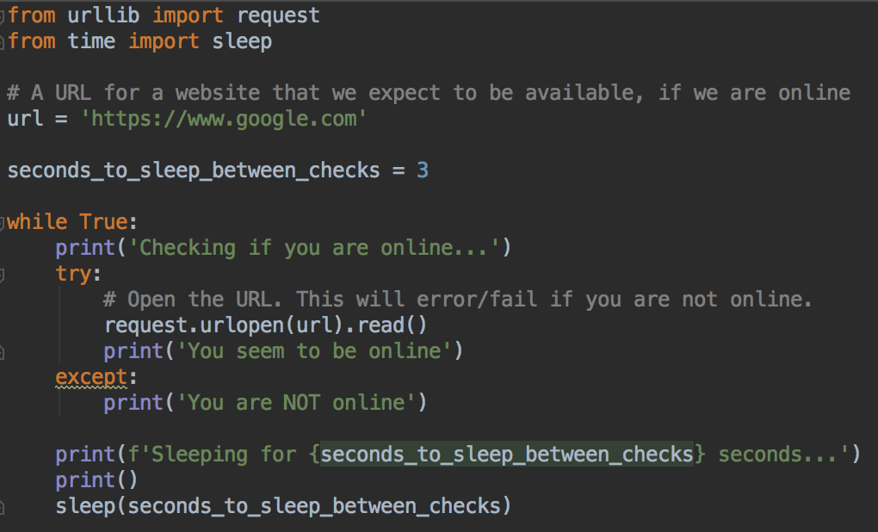
While true loops can be useful – check for internet connection
Try running this program
Press red stop button to end the program
Testing if you are online
Could extend this program to make a noise when you are online

Slide 32
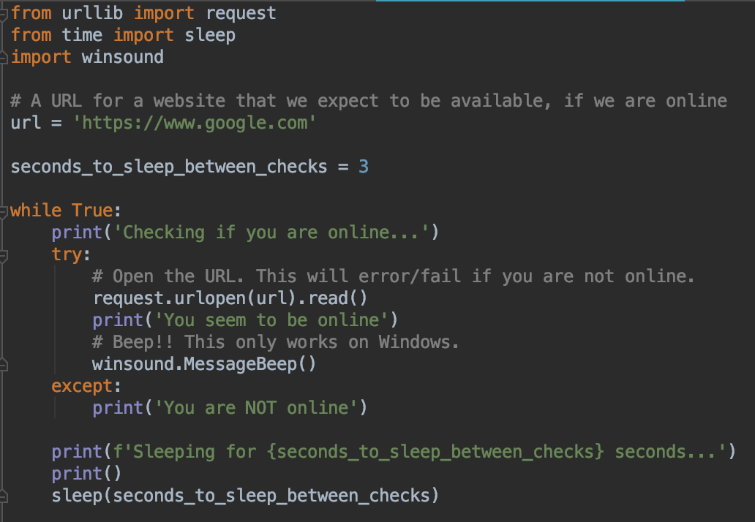
Making a sound when you are online: Windows
Add these lines
Beep!

Slide 33
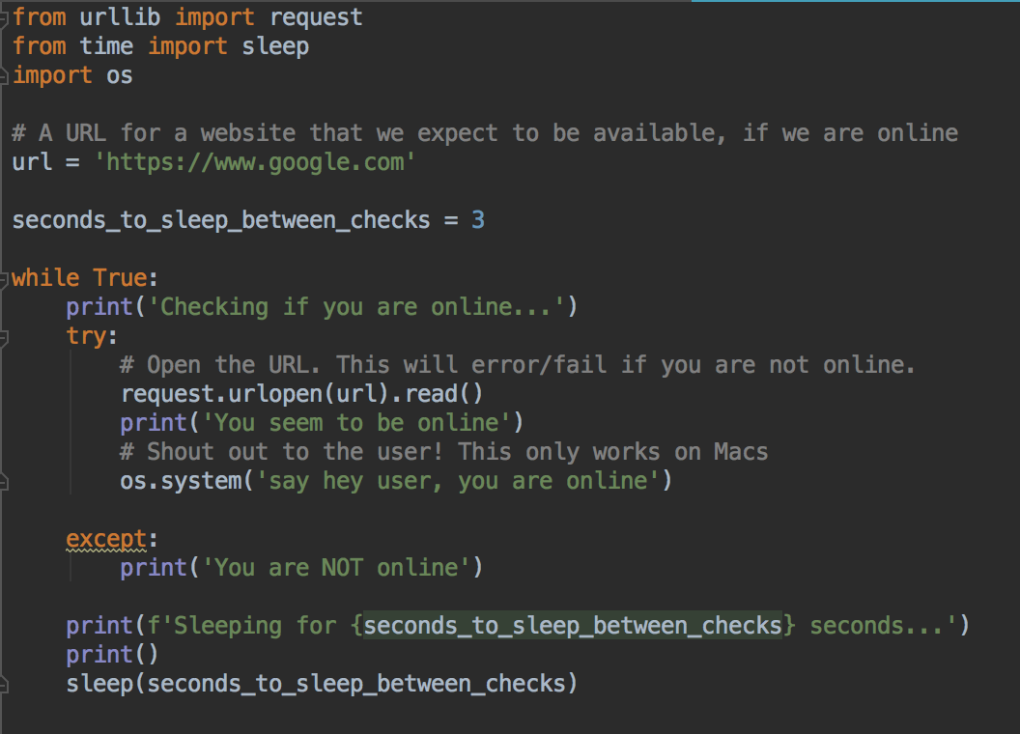
Making a sound when you are online: Mac
Add these lines
runs the say program on MacOS
After the word say, put any message you like, for example:
os.system('say beep')
os.system('say hello internet!')

Slide 34
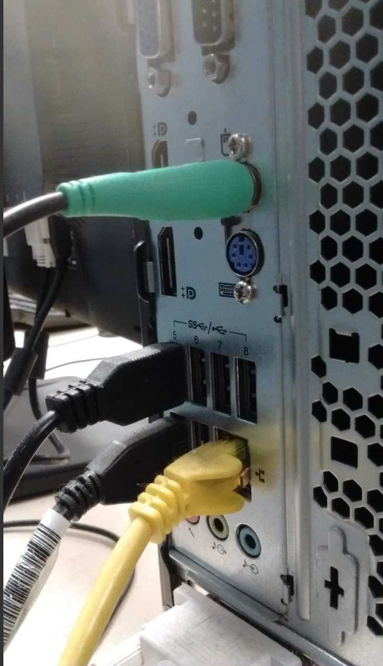
Testing
Laptops: turn your Wi-Fi off and on
Lab PCs: unplug the yellow ethernet cable from your PC
Please don't forget to plug it in again
Ethernet cable

Slide 35
for vs while
Two types of loops - which one to choose?
We wrote a very similar program to add up textbook prices as a for loop, and as a while loop
It turns out that you can write most loops as a for loop or a while loop
But, some types of problems are easier to write as a for loop
And other problems are usually easier to write as a while loop

Slide 36
for vs while
Two types of loops - which one to choose?
Use a for loop if:
If you have to do something a known amount of times (or you'll have a variable with the number of repetitions in)
If you have to do a task once per row of a spreadsheet, once per pixel, once per character in a string....
Use a while loop if:
You need to repeat forever
You don't know how many times you'll need to repeat
You'll be able to figure out that the loop needs to end while the loop is running

Slide 37
Good programming style
Use concise but descriptive variable names
Comment your code, especially the tricky parts
Use format strings where appropriate
Do all of these when you work on your lab assignments

Slide 38
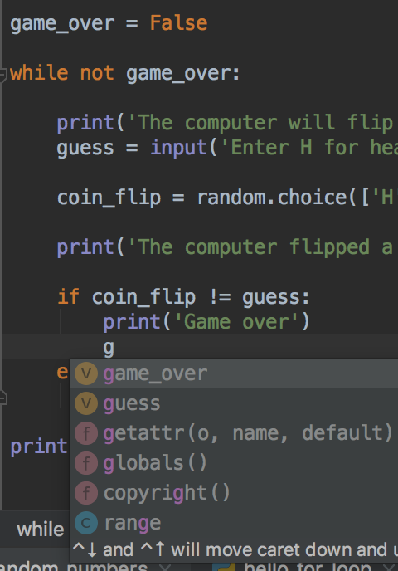
Variable names
Good practice: use descriptive variable names
Try and describe what data is in your variable
Good variable names are concise but informative
PyCharm and other editors have autocomplete so even if you have a longer variable name
Press tab while you are typing to autocomplete PyCharm's suggestions
Use up and down arrows to move between suggestions
Pressing tab now would autocomplete game_over

Slide 39
Lab Time
Lab is in D2L
Questions? Need help? Ask me or the tutors
Office hours, email, visit Academic Success Center
Thank you!

